Slide 1


CMR TECHNICAL CAMPUS
UGC AUTONOMUS
DEPARTMENT OF CSM
PERSONALISED CANCER DIAGNOSIS USING MACHINE LEARNING
PRESENTED BY:
1. NAME : ANANTH DEV PRAJAPAT
ROLLNO : 227R1A7368
2. NAME : SUDINI SREEKAR REDDY
ROLLNO : 227R1A73C6
3. NAME : AJAY
ROLLNO : 227R1A73C7
UNDER THE GUIDANCE OF:
Assist.professor G.PARVATHIDEVI

Slide 2

ABSTRACT
DISADVANTAGES WITH EXISTING SYSTEM
PROPOSED SYSTEM
SYSTEM ARCHITECTURE
USECASE DIAGRAM
CLASS DIAGRAM
SEQUENCE DIAGRAM
ALGORITHMS/MODULES
DATASET DESCRIPTION
SCREEN SHOTS
PERFORMANCE METRICS
RESULTS-COMPARISION GRAPH
CONCLUSION AND FUTURE SCOPE
contents

Slide 3

ABSTRACT
This project leverages Machine Learning (ML) algorithms to enhance diagnosis.
Personalized predictions based on patient-specific data, genetic markers, and medical imaging.
Uses ML techniques like Random forest Classifier, Logistic Regression
Trained on publicly available datasets (TCGA, Kaggle) for high accuracy.
Helps reduce false diagnoses and supports oncologists in decision-making.
Aims to improve early detection and enhance patient care through AI-driven insights.

Slide 4
DISADVANTAGES WITH EXISTING SYSTEM
Manual diagnosis is time-consuming
Early symptoms are often overlooked
Prone to human errors in interpretation
No support for predictive or preventive care
Lack of intelligent decision-making systems
Limited access to healthcare in rural areas
Diagnosis depends heavily on clinical expertise
High cost for advanced testing and consultations

Slide 5
PROPOSED SYSTEM
✅ Develop an AI-driven system for personalized cancer diagnosis.
✅ Enhance early detection of cancer using Machine Learning (ML).
✅ Improve diagnostic accuracy by analyzing patient-specific data.
✅ Uses ML techniques like Random forest Classifier, Logistic Regression
✅ Reduce false diagnoses and assist oncologists in decision-making.
✅ Train models on real-world datasets (TCGA, Kaggle) for reliable performance.
✅ Provide personalized predictions based on genetic markers and medical imaging.
✅ Support medical professionals in delivering better and faster treatment.

Slide 6
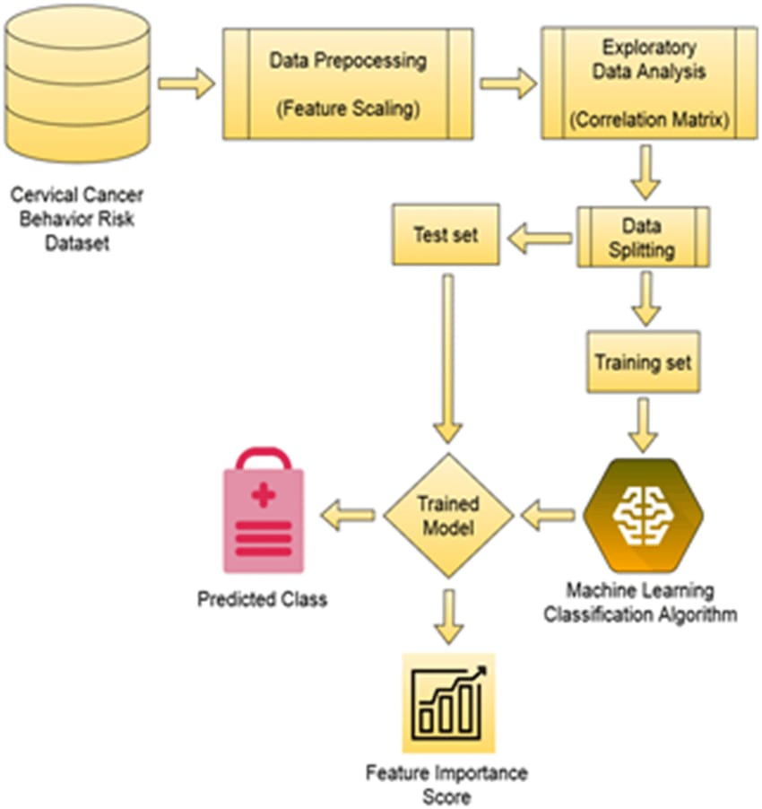

SYSTEM ARCHITECTURE
Datasets

Slide 7
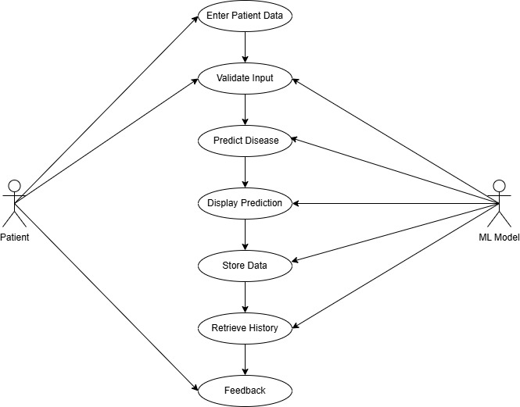
USECASE DIAGRAM

Slide 8
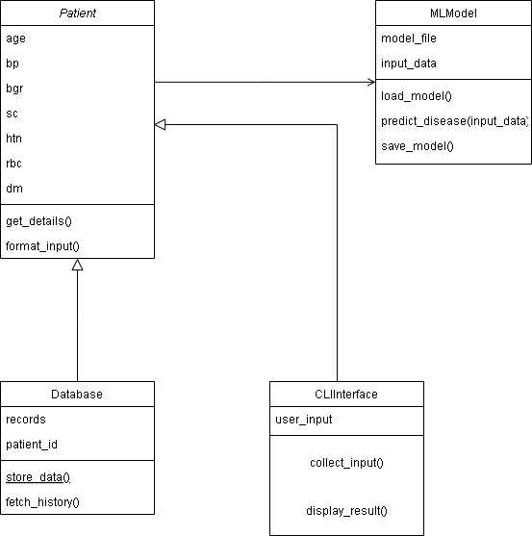
CLASS DIAGRAM

Slide 9
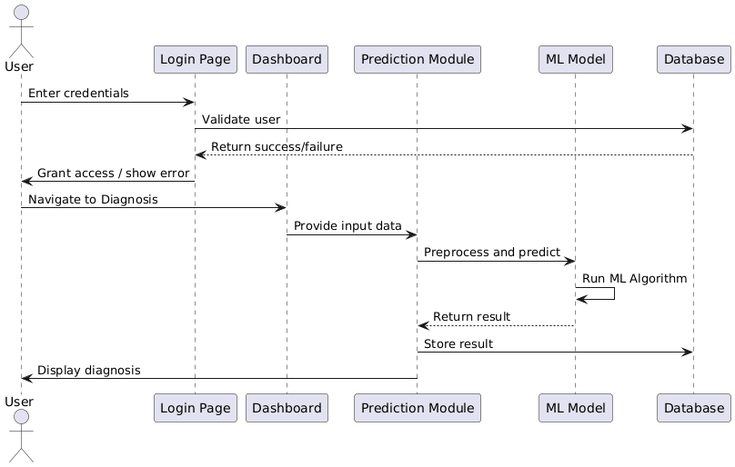
SEQUENCE DIAGRAM

Slide 10
Random forest Classifier
Logistic Regression
Algorithms

Slide 11
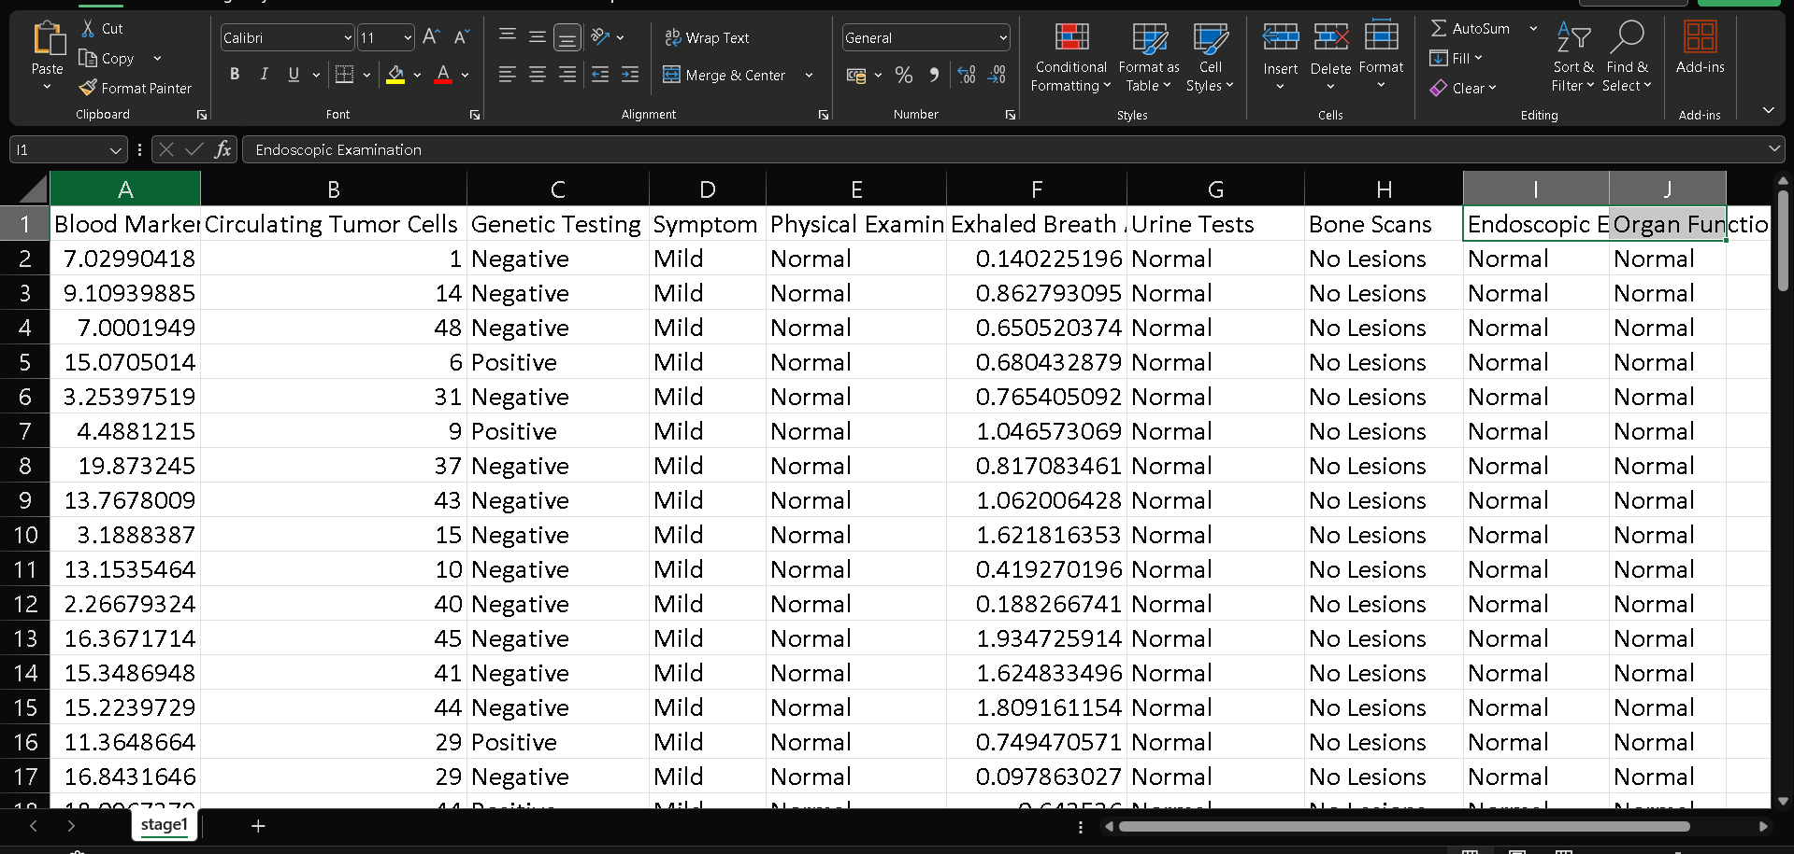
CONCDATASET DESCRIPTION
LUSION
This is medical study data. Each row is a patient. Columns show blood markers, genetic results (Positive/Negative), symptoms (e.g., Mild), physical/other test results (e.g., Normal, No Lesions), and organ function. The first few rows present individual patient data across these measures.

Slide 12
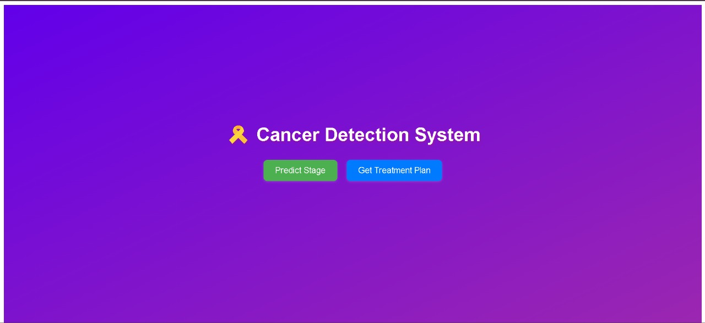
SCREEN SHOTS
HOME PAGE

Slide 13
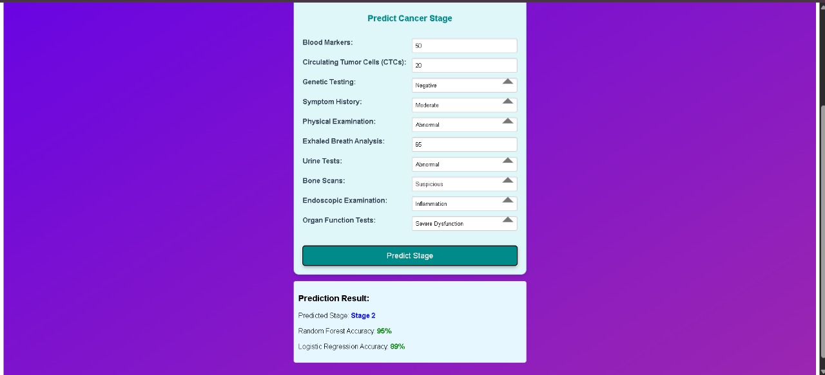
PREDICTION PAGE

Slide 14
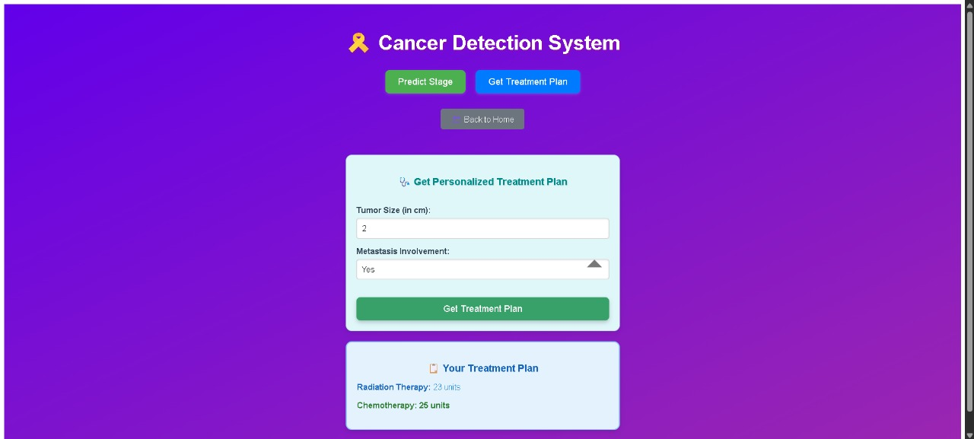
TREATMENT PLAN PAGE

Slide 15
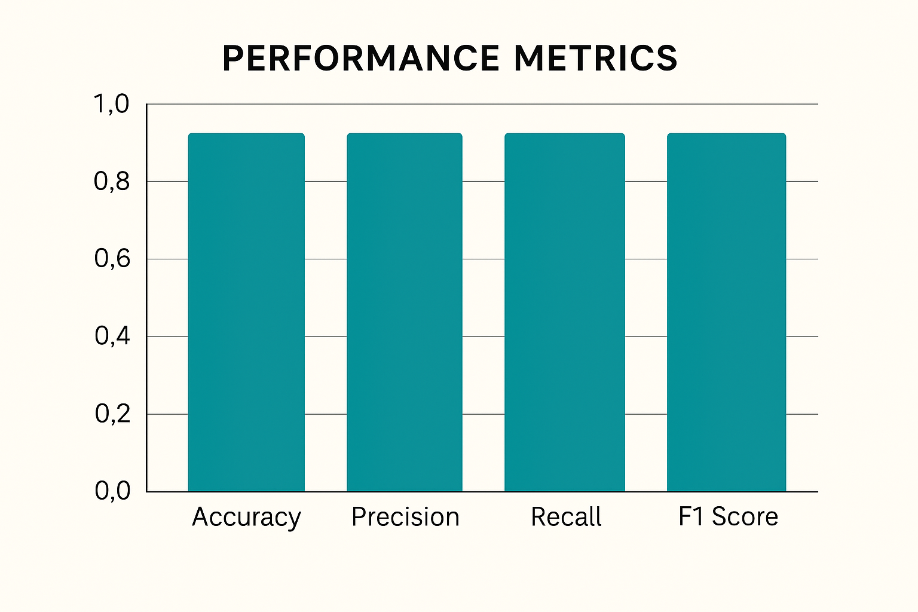
PERFORMANCE METRICS

Slide 16
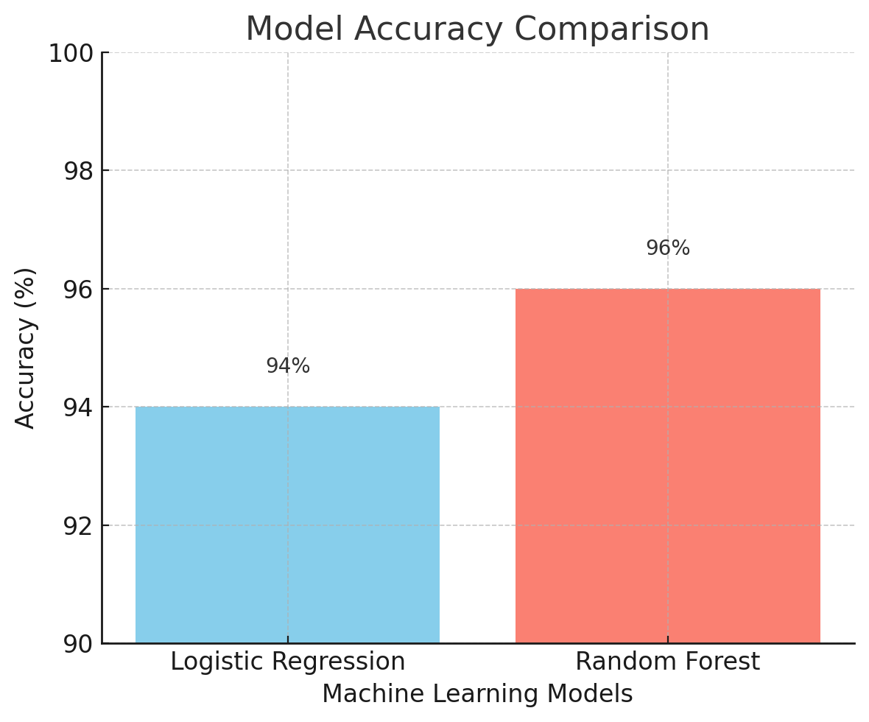
RESULTS-COMPARISION GRAPH

Slide 17
CONCLUSION AND FUTURE SCOPE
Conclusion:
Future Scope:
Integrate deep learning techniques for improved prediction.
Deploy the model as a web/mobile application for real-time diagnosis support.
Use larger and more diverse datasets to increase reliability.
Collaborate with healthcare institutions for clinical validation.
The project successfully implemented machine learning techniques for personalized cancer diagnosis.
Logistic Regression and Random Forest models showed high accuracy, with Random Forest performing the best.
The system aids early detection, improving chances of timely treatment.

Slide 18


